Slide 1
My body: Names of parts of the body and their functions
I can name parts of my body.
I can talk about the different parts of my body and what they do.
I can describe the changes that take place with puberty.

Slide 2
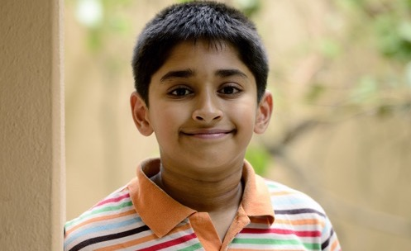
What is puberty?
Puberty is the time in your life when your body begins to change.
Some changes you can see.
Some changes happen inside your body. You can’t see these.

Slide 3
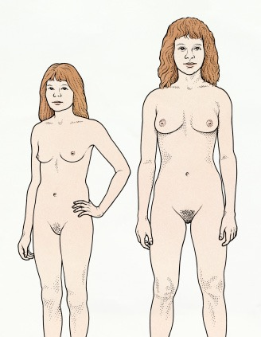
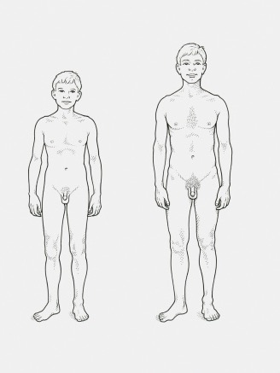
Activity: Names for parts of our body

Slide 4
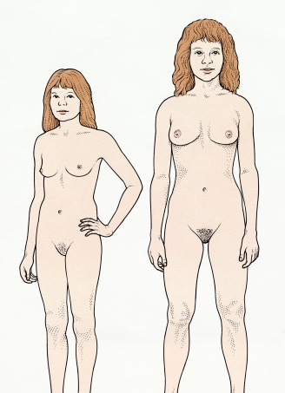
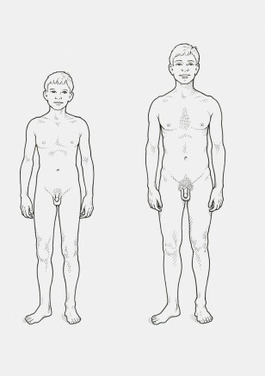
Nipples
Both boys and girls have nipples.
When a girl grows, she will develop breasts.
If a woman has a baby, then she can breast feed her baby; the baby would get milk from its mum’s nipples.

Slide 5
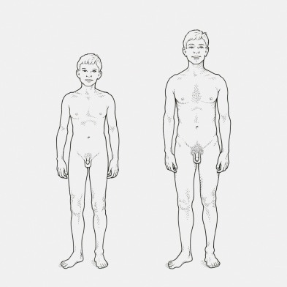
Penis
Boys have a penis. Every penis is different. When a boy urinates, it comes out of his penis.
Scrotum and testicles
The scrotum is the sack of skin that hangs under the boy’s penis. Inside there are the testicles.

Slide 6
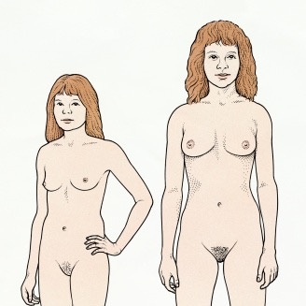
Vulva
Girls have a vulva. Every vulva is different.
When a girl urinates, it comes out of her vulva.

Slide 7
Nipples
Nipples
Penis
Vulva
Scrotum

Slide 8
The genitals are the private parts of our bodies. For the boy the penis and scrotum and for a girl the vulva.
Connected to our genitals, inside our body, are parts of our body called reproductive organs because they are used to make a baby.

Slide 9
Male reproductive organs (unlabelled)

Slide 10
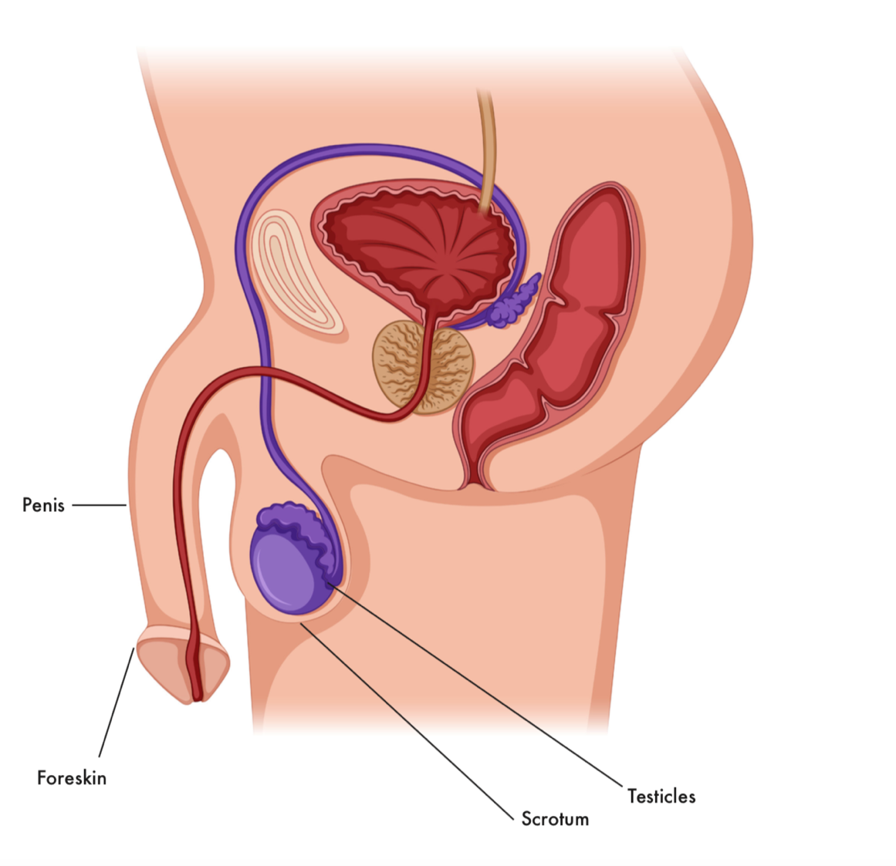
Male reproductive organs (labelled)

Slide 11
Female reproductive organs 1 (unlabelled)

Slide 12
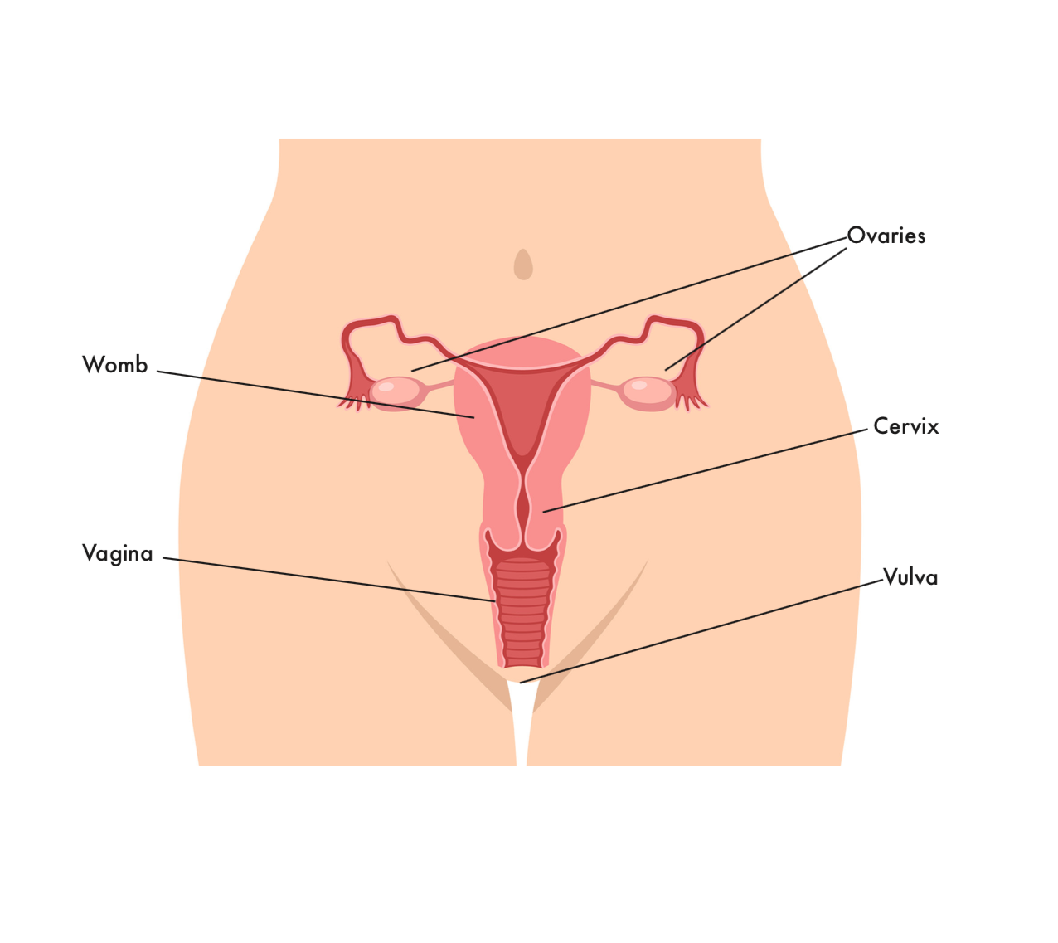
Female reproductive organs 1 (labelled)

