Slide 1
Personal Hygiene
I can describe the changes that take place with puberty.
I understand how to maintain personal hygiene.

Slide 2
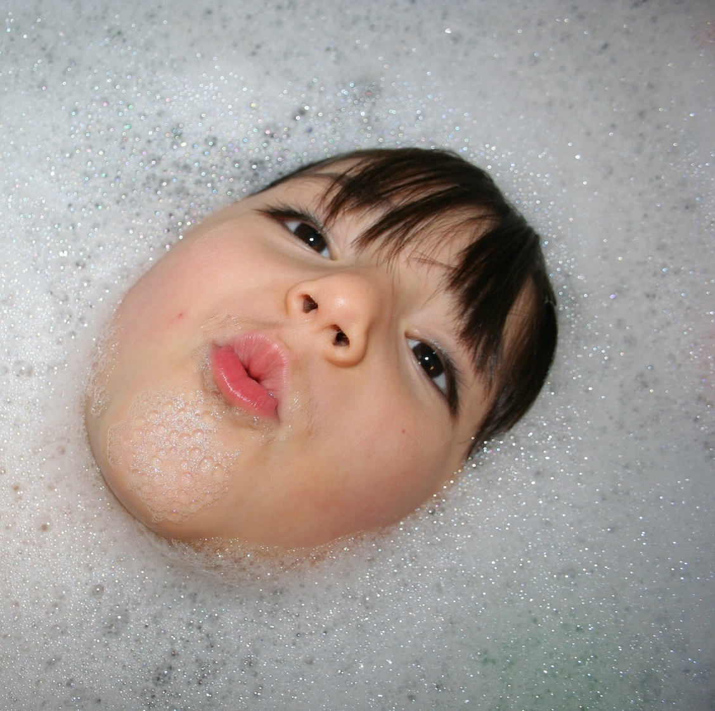
Personal hygiene is about keeping yourself clean.

Slide 3
What parts of our body do we need to keep clean?
How do we keep ourselves clean?

Slide 4
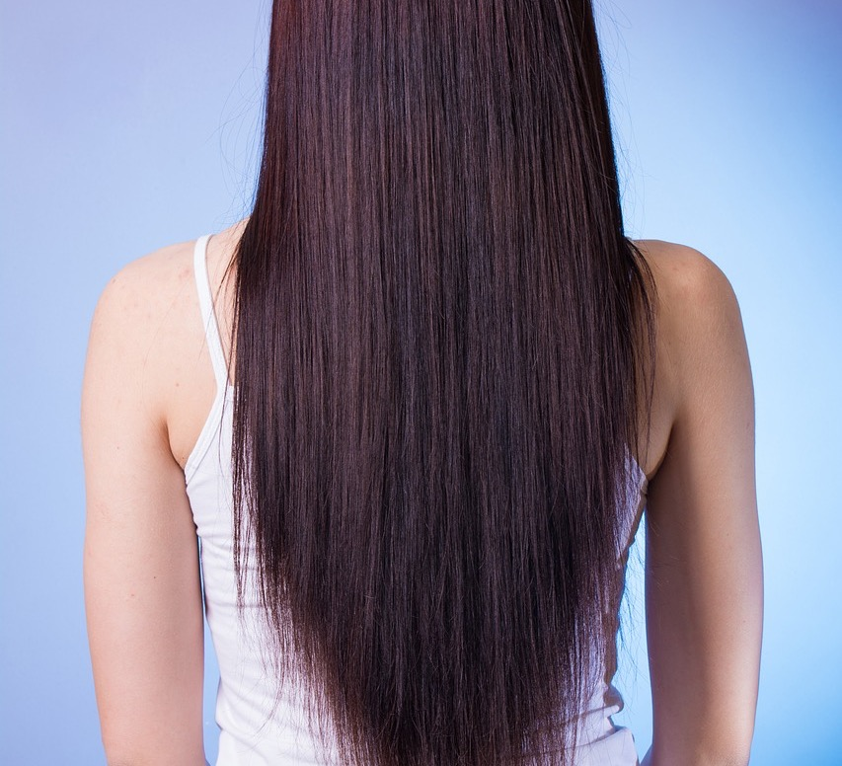
Oily hair
Each strand of hair has its own oil gland that keeps the hair shiny and waterproof.
During puberty, when the glands produce extra oil, it can make your hair look too shiny, oily, and greasy.
Washing your hair regularly can help control oily hair.

Slide 5
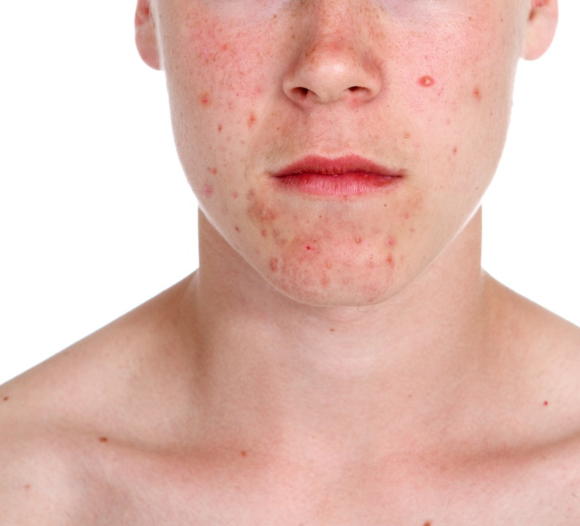
Spots
This can be called acne or pimples.
You get spots with puberty because your skin gets oily.
You can get spots on your face, chest, back and bottom.
You need to keep your skin clean.
Try not to squeeze your spots or they will get dirty and infected.

Slide 6
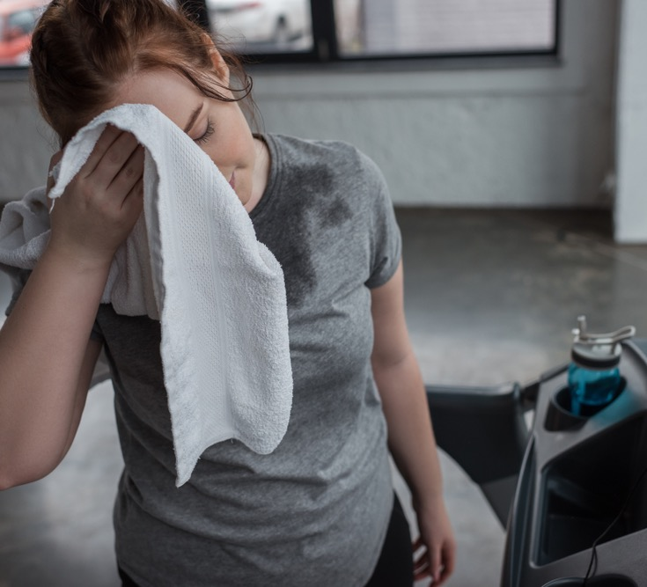
Sweat and body odour
When puberty begins you will sweat more.
Your sweat glands produce a new body odour with a stronger smell.
Sweat can cause our body or clothes to smell bad. This is called body odour (or B.O.)

Slide 7
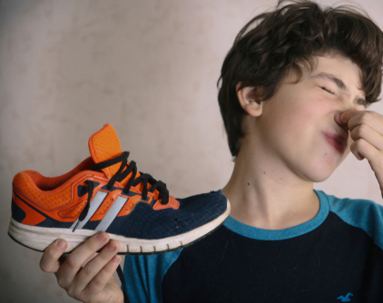
Sweat and body odour
You will notice sweat and new smells under your arms and maybe your feet and genitals.
If you don’t keep your body and your clothes clean, then bacteria can grow.
Have a bath or shower every day and wear clean clothes.
Puberty, Body Odour: https://youtu.be/4SRXvGHKA-k

Slide 8
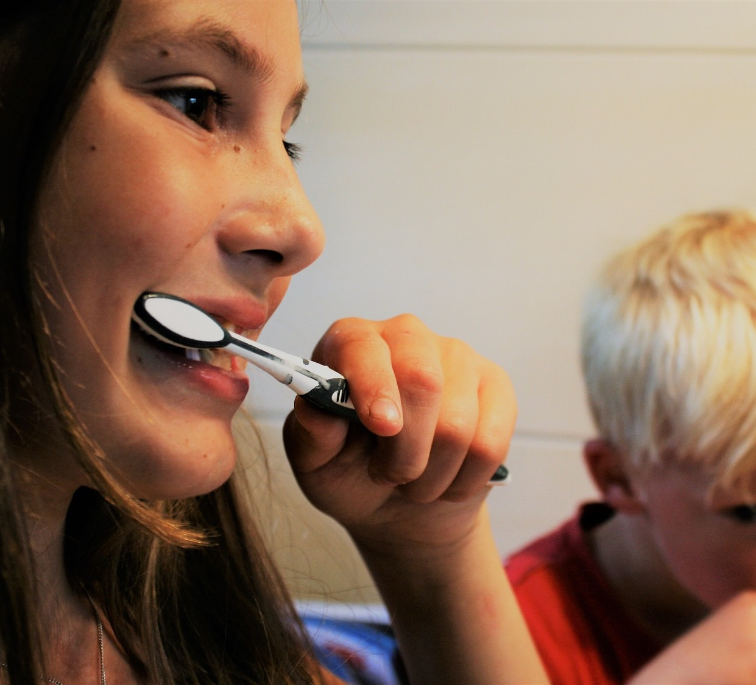
Oral hygiene
Puberty doesn’t make a difference to your oral hygiene – its just a good idea to always look after your mouth, gums and teeth!
So brush your teeth twice a day.

Slide 9
Personal Hygiene Team Task
Things I need to do every day…
Things I do regularly…
Things I might need help with…

Slide 10
Top tips?
If you were to give your top tip to other children and young people about personal hygiene, what would it be?

