Slide 1
Consent: My body is mine
I can describe what consent means to me.
I know that I, and others, can use words, body language and facial expression to communicate what they like and don’t like.
I explain the idea of personal space.
I can explain that my body is my body.
I can name an adult/adults I go to if I have a worry.

Slide 2
Consent
Consent means asking someone’s permission to do something.
If they say yes, they have given their consent.
If they say no, they have not given consent.
If a person is not sure, or does not say ‘yes’, then this is not consent.

Slide 3
Video: Consent for kids www.youtube.com/watch?v=h3nhM9UlJjc Duration: 2 minutes 42 seconds

Slide 4
Body autonomy means your body is your body. Your body belongs to you. You are the boss of your body.

Slide 5
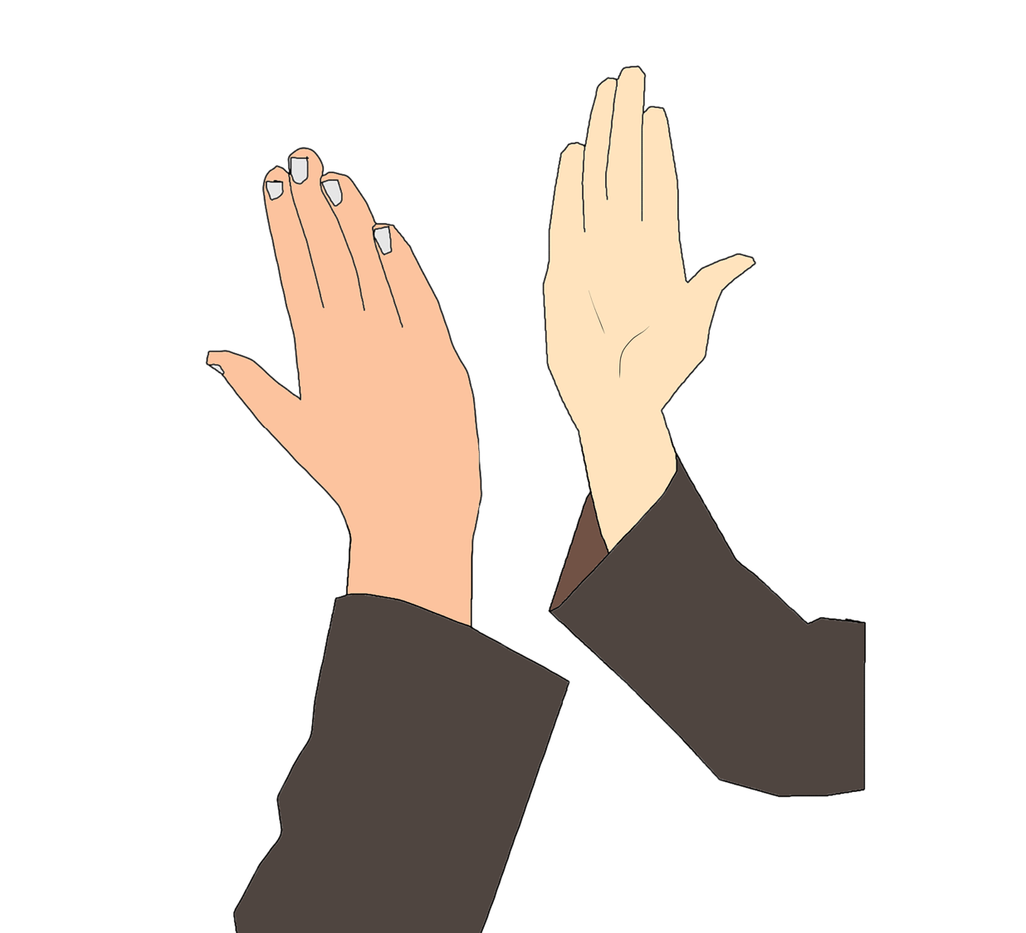
The shake/hi-five/hug game. Team 1 person says: “Hello! Would you like to…?” Team 2 person gets to pick or just says: “None of these thanks, I’ll just say hello”.

Slide 6
Listening to our belly voice.

Slide 7
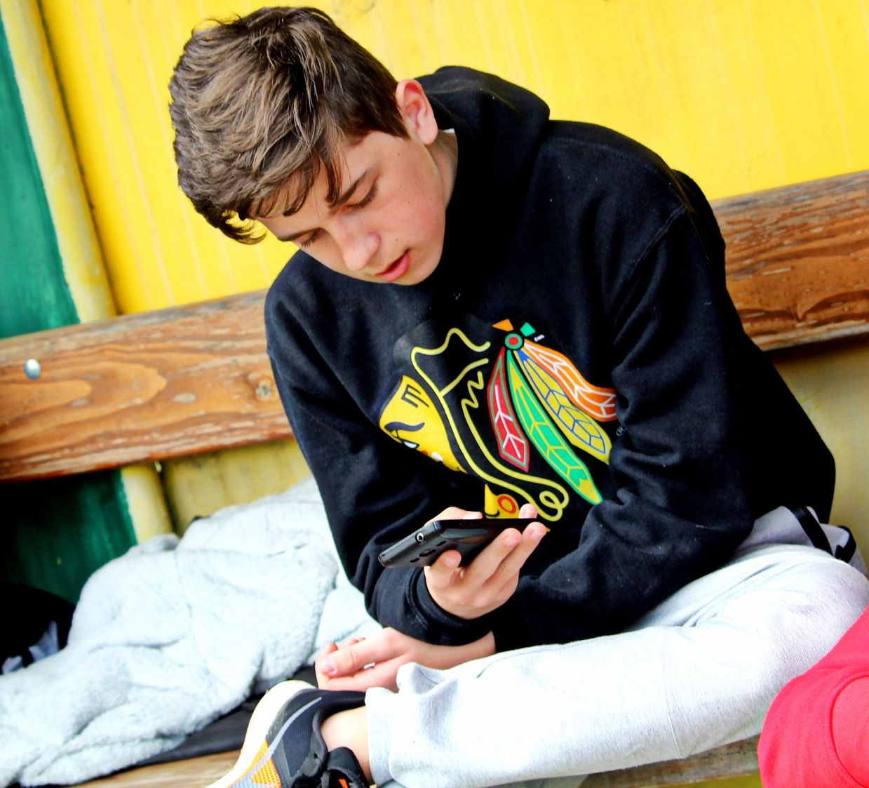
Listening to our belly voice Scenario 1:
Ava was playing outside.
A boy she knows said “Come here, there’s something I want to show you on my phone”.
The other boys were looking at his phone and laughing.
Ava said” No thanks, I don’t want to see it” and kept playing with her friend.
Did Ava do the right thing? What else could Ava do?

Slide 8
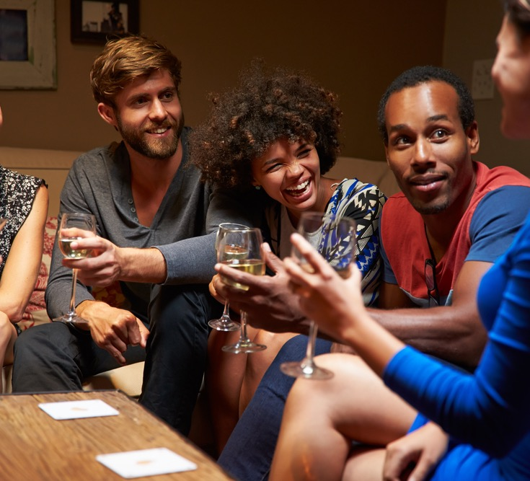
Listening to our belly voice Scenario 2:
Joe was playing at his friends house and there was a party going on, there were lots of adults.
One of the grown-ups said to Joe “Come and sit here with me”.
But Joe didn’t want to. In his tummy he was feeling nervous about the man.
So he said “No, I’m going out to play” and he left.
Did Joe do the right thing?
What else could Joe do?

Slide 9
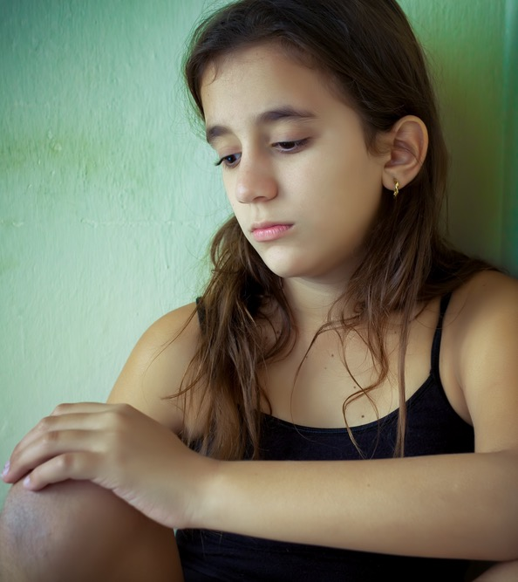
Listening to our belly voice Scenario 3:
Emma was at the local shop on her own.
Some older girls were there too. They were really friendly and said: “ Come with us. There’s a party at our house and we’ve got cigarettes and vodka. It’ll be fun”.
Emma wasn’t sure what to do. She wanted to go. At first she said “Yes”.
But then she said: “No thanks. I’ve just remembered my Gran said to come right home”.
Did Emma do the right thing?
What else could Emma do?

Slide 10
Do you ever get that feeling in your tummy or body that makes you feel something isn’t right?
Who do you go to if you have a worry or a question?

Slide 11
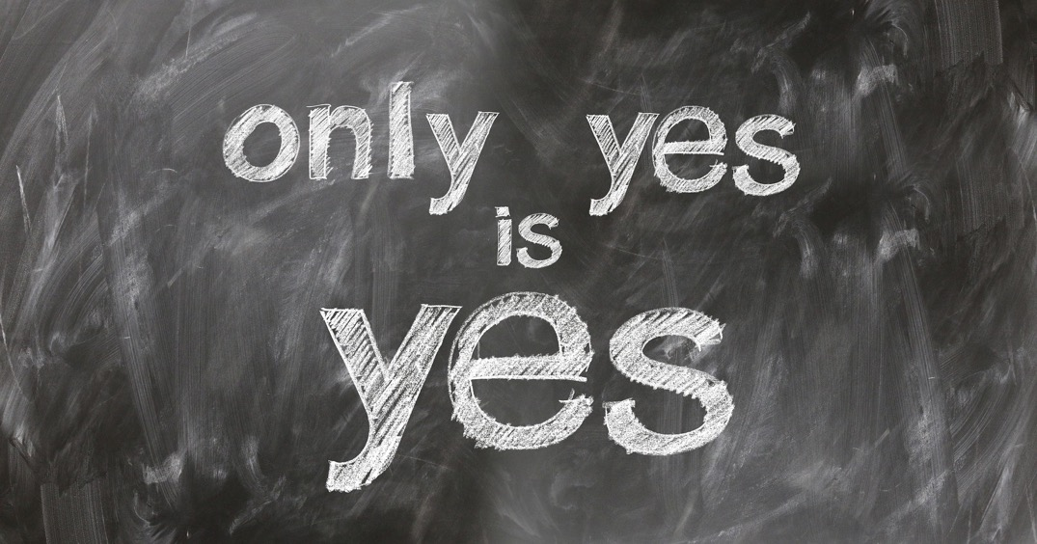
Video: Boss of My Body https://youtu.be/zAALZxa6NCw Duration: 2 minutes 33 seconds Video: Consent for kids www.youtube.com/watch?v=h3nhM9UlJjc Duration: 2 minutes 42 seconds

Slide 12
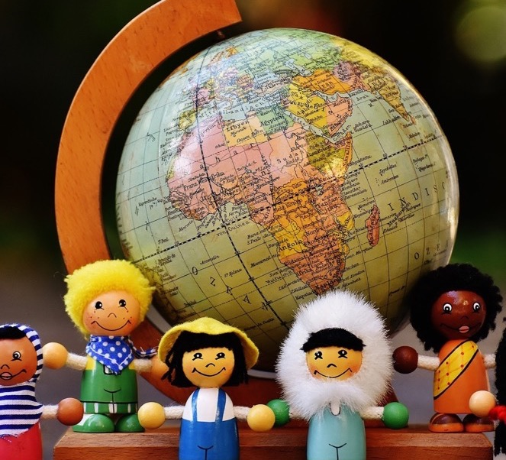
In this class, we are all individuals, different, unique and special.

