Slide 1
Puberty
The effects of puberty on my emotions
I will be aware of links between my mood swings and the changes I am going through
I will explore how to best deal with my mood/ anger/ frustration in this ‘in between’ stage in my development as an adult

Slide 2
What is puberty?
An increase of hormones
Body changes (height, hair growth, body shape)
Physical
Seeing yourself as an individual
Seeing others in a different way (parents, teachers, etc)
Emotional

Slide 3
What causes conflict with my parents?
Homework
Clothes
Video games
Internet usage
Music choices and volume
Friends
Bedroom
Choice of leisure activities

Slide 4
What causes conflict with my friends?
Other friendships, new mates
Misunderstandings, arguments
Girlfriends or boyfriends
Choice of things to do together
The way they talk to me, making me feel bad about myself
They do not listen to me, they only talk about themselves
Jealousy

Slide 5
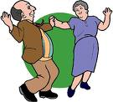
How to keep parents happy
Keep them involved, tell them your plans, how are you feeling about things
Ask their advice, listen and if you disagree tell them why
Accept that they have the right to lay down some rules, be willing to meet them halfway
Try not to lose your temper, if you show them you can accept when they say no, may be they will be willing to say yes in the future
When going out, tell them where and with whom, agree a time when you will return and ALWAYS let them know I you are going to be late
Help more around the house, without waiting to be asked

Slide 6
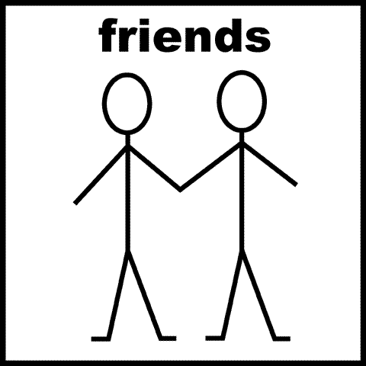
Give and take with friends
Try to not demand too much support and attention without giving some in return, they will find resentful and used
Show mutual respect, try to feel the same way about each other
If you let a friend make you into a doormat by telling you how to behave and what to do, then you are not being fair to yourself or to them.

Slide 7
Body language
Think tall, take a deep breath, unfold your arms, drop your shoulders… you’ll see the difference!
Keep hands down, avoid trying to hide any part of your face with your hands… this will only call attention to what you want to hide.
Sit on your hands if you have to! Playing with your hair chewing your nails or sucking your fingers or thumb are dead giveaways if you are feeling insecure.
Make eye contact, looking away says that either you think they are boring or you are scared of them.

