Slide 1
My body: My body is changing
I can name parts of my body.
I can talk about the different parts of my body and what they do.
I can describe the changes that take place with puberty.
I can talk about my growing independence.
I can talk about things I can do when I am upset and can identify an adult to speak to if I am upset.
I understand how to maintain personal hygiene.

Slide 2
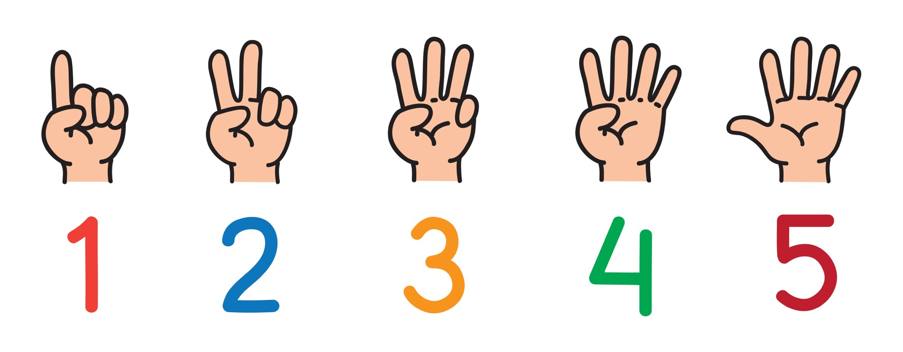
Can you name 5 ways your body has changed since you were a baby?

Slide 3
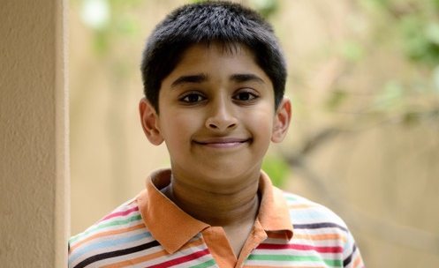
What is puberty?
Puberty is the time in your life when your body begins to change.
Some changes you can see.
Some changes happen inside your body. You can’t see these.
You can have stronger emotions and new feelings.

Slide 4
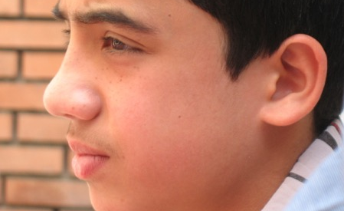
When will puberty happen to me?
Puberty changes happen over several years. Usually between the ages of 9 and 16.
Some changes in your body might be happening now, some will happen later. This is different for everybody.

Slide 5
All the changes that happen during puberty are caused by chemicals in your body. These chemicals are called hormones.
When your body is ready to begin puberty, your pituitary (say: pih-TOO-uh-ter-ee) gland (a pea-shaped gland located at the bottom of your brain) releases these special hormones.
Depending on whether you're a boy or a girl, these hormones go to work on different parts of the body.

Slide 6
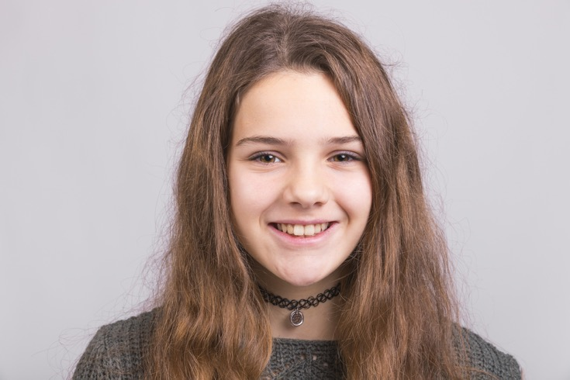
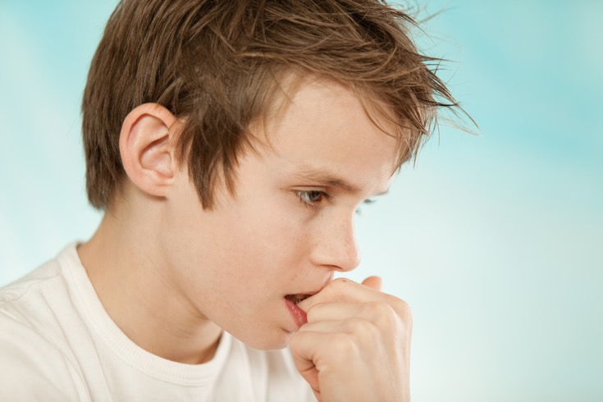
When we go through puberty what happens to… Hair? Skin? Body shape? Breasts? Voices? Smell?

Slide 7
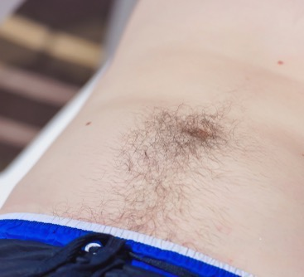
What happens to hair?

Slide 8
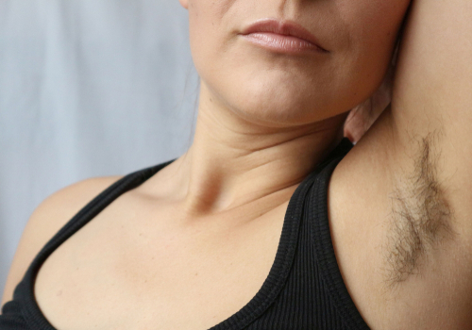
Hair
Hair can grow on your face, around your genitals (private parts), arm pits (under your arms) and on your body.
Head hair can get oily and need washed more often.

Slide 9
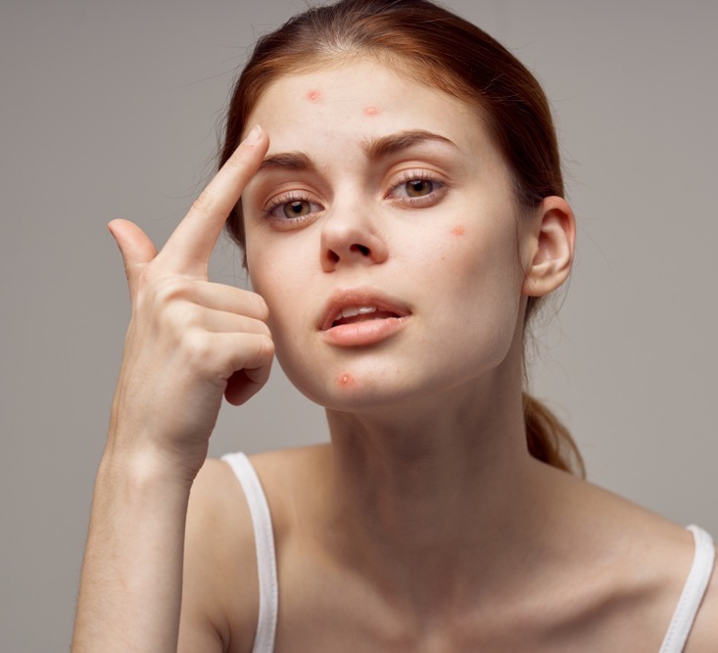
What happens to skin?

Slide 10
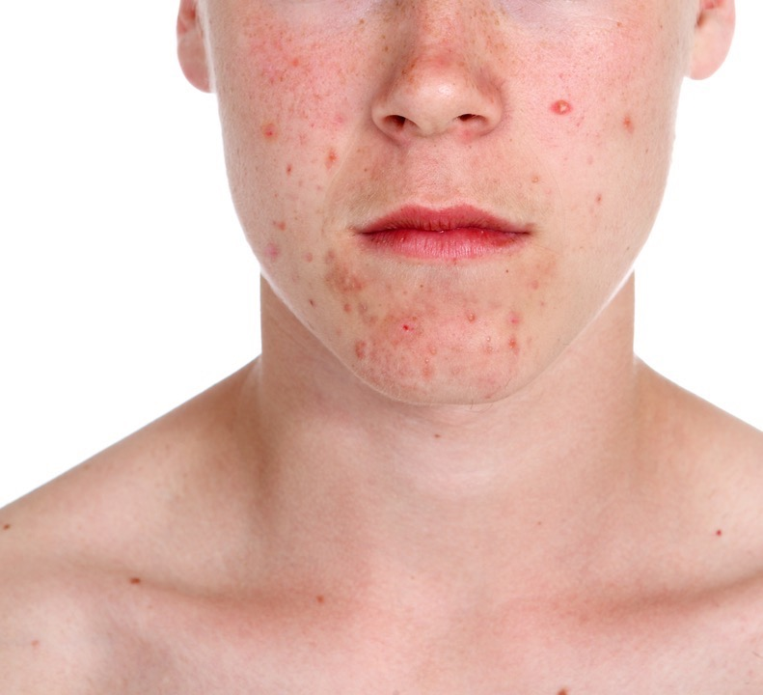
Skin Both girls and boys can get spots (acne). Spots happen because your skin gets oilier.

Slide 11
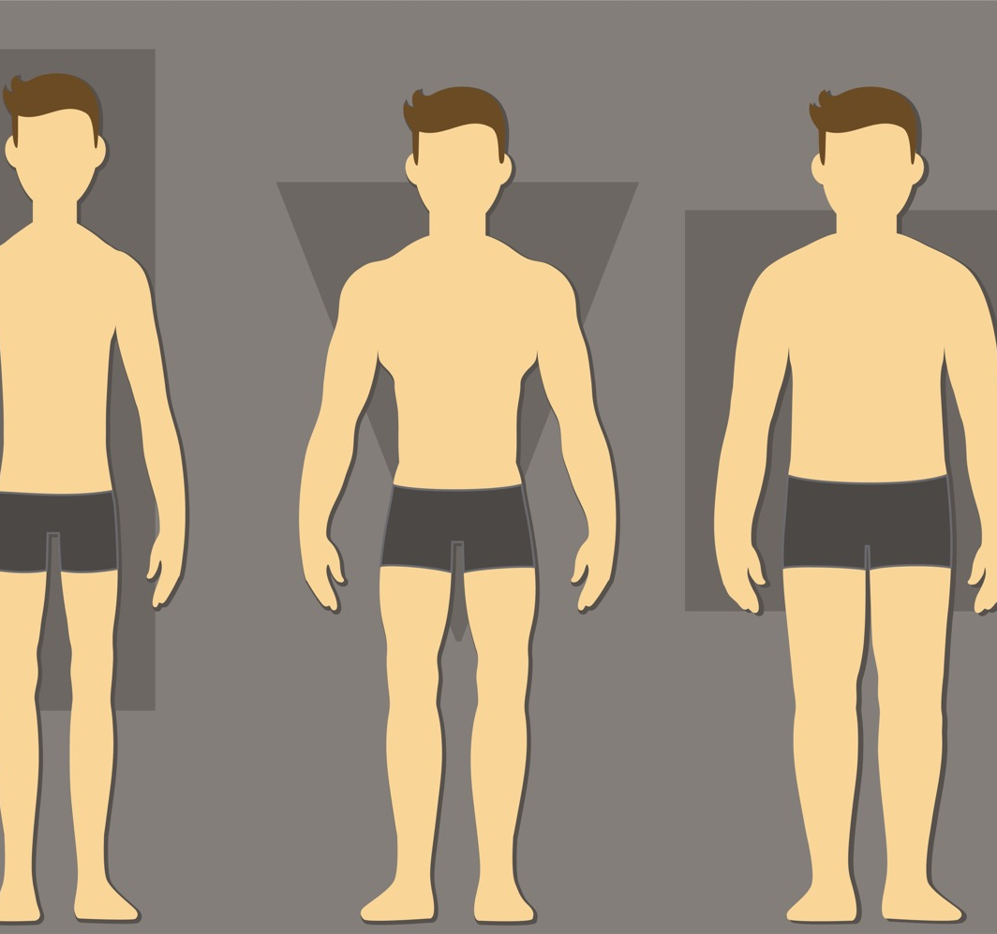
What happens to body shape?

Slide 12
Body shape
Boys and girls grow taller.
Boys get broader across the shoulders and their body becomes more muscular.
Girls’ hips widen and their waist becomes narrower.

Slide 13
What happens to breasts?

Slide 14
Breasts
Breasts get bigger and rounder as they grow.
Every girls' breasts are different. Boys can sometimes have growth in their breast area too.

Slide 15
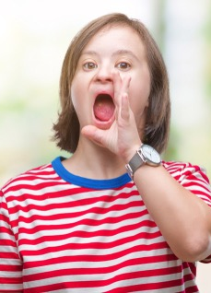
What happens to voices?

Slide 16
Voices
Boy’s voices can get deeper.
Girls voices might become deeper too. This happens over time.

Slide 17
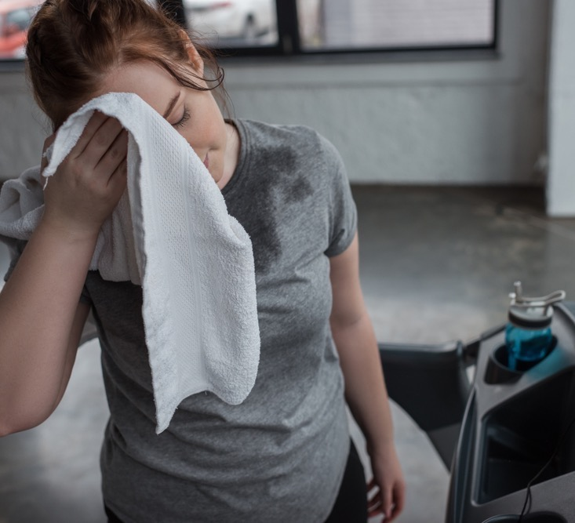
What happens to body smells?

Slide 18
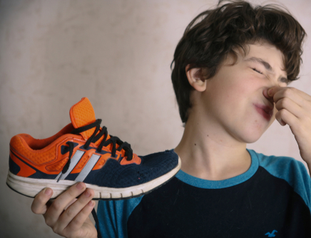
Smell
Boys and girls sweat more when they go through puberty.
Sweat can make your clothes or body smelly.
It is important for girls and boys to wash themselves and change clothes more often.

Slide 19
Some changes that happen to boys and girls are to get your body ready to have a baby when you grow up, if you want to.

Slide 20
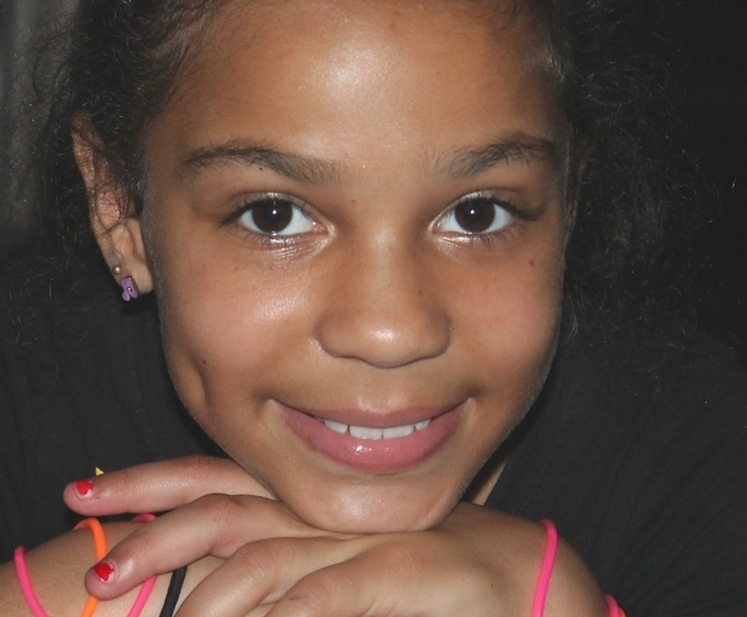
Periods
When a girl goes through puberty her ovaries release an egg every month.
For a few days each month blood and other fluids pass out through the girl’s vagina. There can be some fluids called pre-period discharge before the period starts.
Periods are also called menstruation.

Slide 21
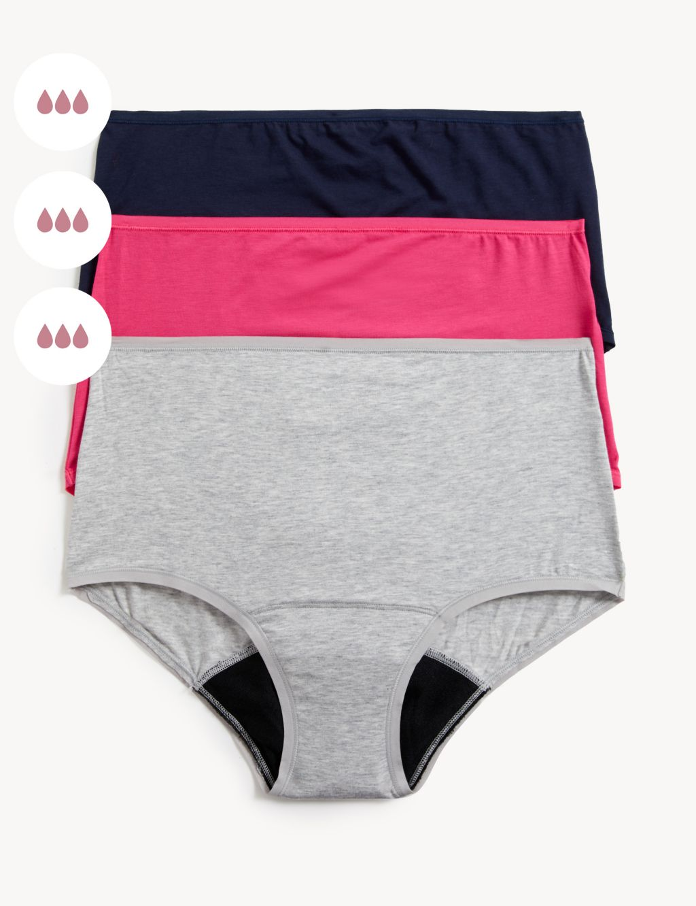
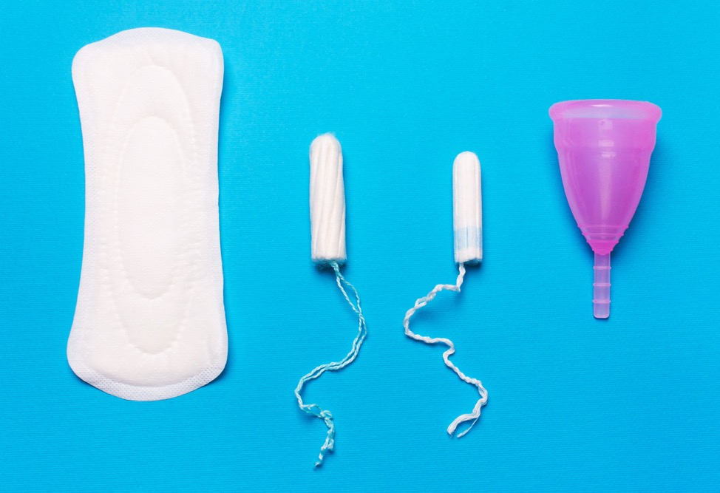
When a girl has her period she wears a sanitary towel or tampon or period pants, or menstrual cup to absorb the fluid.

Slide 22
During a period, girls can feel that it is a bit painful or uncomfortable.
A girl can still do anything she wants when having her period.
Girls start having their period at different ages. Every girl is different and unique!

Slide 23
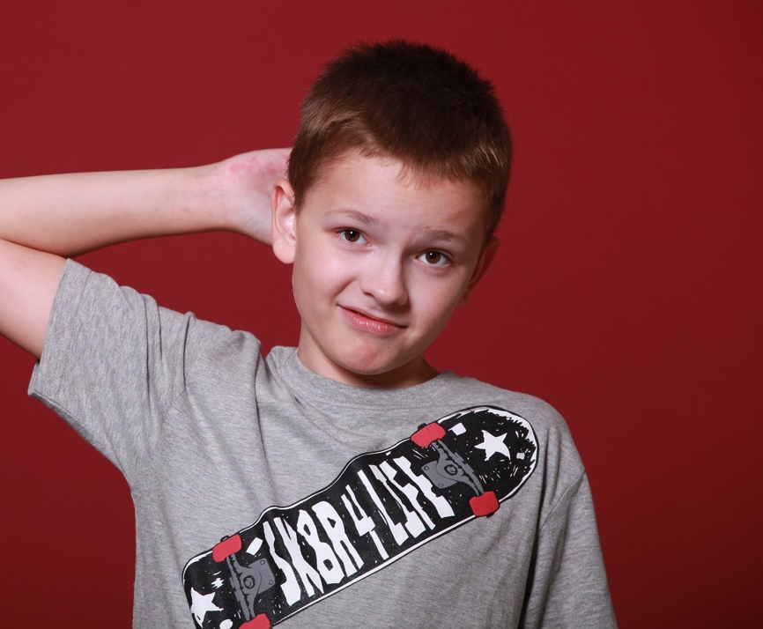
Erections
An erection is when the boy’s penis goes hard and sticks out from his body.
Erections are normal. They can happen at any time. They can last a few minutes or a bit longer. After a while the erection will stop, and the penis will be soft again.

Slide 24
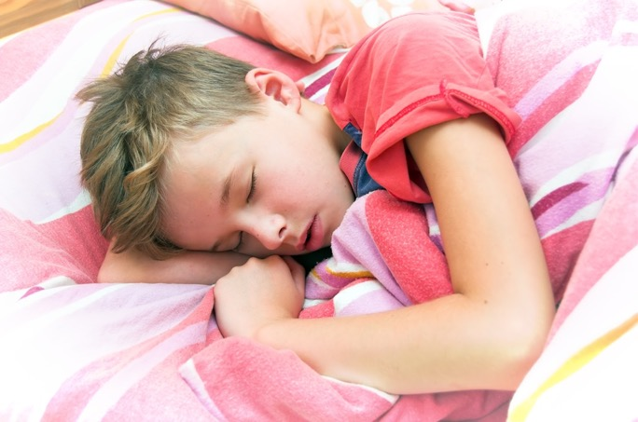
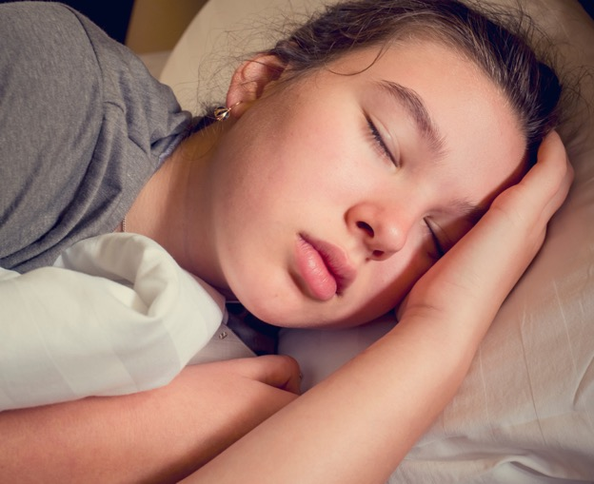
Wet dreams
When a boy is asleep, he can get an erection. He might ejaculate. Ejaculation is when semen comes out of the boy’s erect penis.
When a girl is asleep her vulva can become wet and slippery.
Not everyone has wet dreams but if you do this is normal.
If you wake up in the morning and your underwear and sheets are wet and sticky, you had a wet dream. Take off your dirty underwear and pyjamas. Remove your dirty sheets. Wash yourself and put on clean underwear and clothes.

Slide 25
Touching your private parts
Some children touch their penis or vulva because it can be soothing or enjoyable. This is okay.
This should only be done in private.
And remember that your private parts are private, no-one else should touch them.

Slide 26
What have we learned about today that’s been most interesting for you?

